Slide 1
Multiclass Classification
Codes are in Python 3

Slide 2
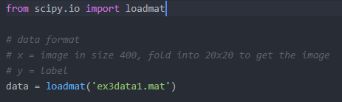
Load dataset
Provided in the format of .mat
Can be loaded using external lib

Slide 3

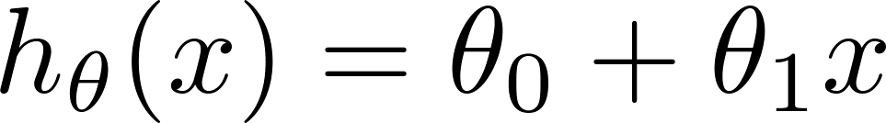
Load dataset
Load the labels
Load the training data

Slide 4
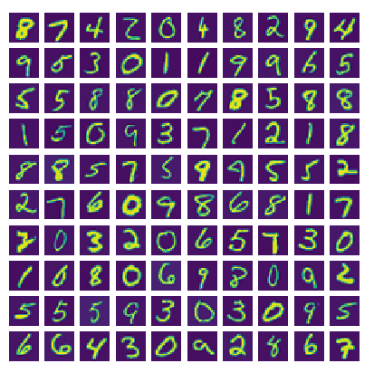
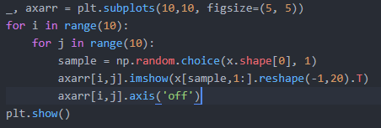
Dataset
Show images from dataset
Subset of the MNIST dataset
Note: 0 is labelled as 10

Slide 5
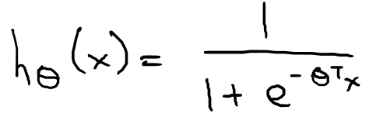

Sigmoid function (Logistic function)

Slide 6
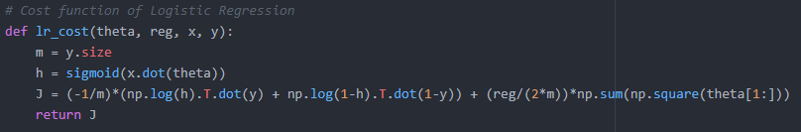
Cost function
Regularized
Vectorized

Slide 7
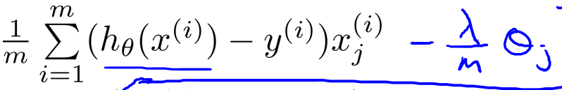

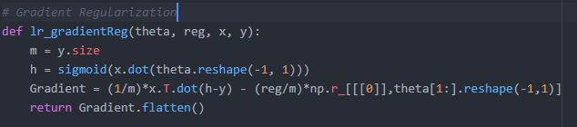
Gradient
Regularized
Vectorized

Slide 8
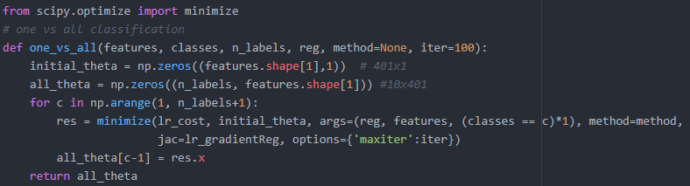
Optimization
Use external library to handle the optimization
The result is 10 model for each different class, store in all_theta

Slide 9

Prediction
Feed in the model and data
Do a dot product on the matrices to get result
Return the max probability of the 10 model
Result is + 1 because Python counts from 0

Slide 10
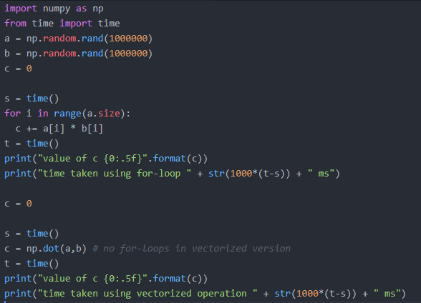

Extra
Purpose of vectorizing

Slide 11
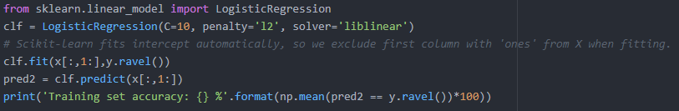
Extra
Can use scikit-learn existing model

Slide 12
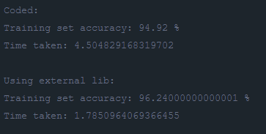
Result

